Slide 1
FCS (Group Theory)
DR. ADEEl HAShmi
Asst. prof., Cse 2nd shift
MSIT

Slide 2
Algebraic Structures
A non-empty set together with one or more operators is called an algebraic structure.
An algebraic structure with a set S and operator @ is represented as (S,@).

Slide 3
Closed Operation
A structure (S,@) is said to be closed with respect to operation @ if the operation @ on elements of the S always produces an element of S e.g. the structure (N,+) is closed as addition of two natural numbers always gives another natural number.
N = set of natural numbers (1,2,3,4, …)

Slide 4
Identity Element (e)
An element e in a set S is called an identity element for the binary operation @, if for every element y in S, y@e = e@y = y.
For example, the identity element for addition is 0 (as, y+0=0+y=y), and for multiplication is 1 (as y·1=1·y=y), but 0 is not identity element for subtraction (as, y−0=y but 0−y≠y) and 1 is not identity element of division (as, y/1=y but 1/y≠y).

Slide 5
Inverse Element (v)
Let S be a non-empty set, @ be any binary operation, and e be the identity element for @, then for each y∈S, if there exists v∈S, such that y@v=v@y=e, then v is said to be inverse of y.
For example, if the binary operation is +, then the inverse of 2 is -2 (as 2−2=0), and if the binary operation is ·, then the inverse of 2 is ½ (as 2·½=1).

Slide 6
Types of Algebraic Structures
The different types of algebraic structures with one binary operation on a set are:
Group
Abelian group
Monoid
Semi-group
Groupoid
The algebraic structures with two binary operations on a set are:
Ring
Field

Slide 7
Group
An algebraic structure (S,@) is called a group, if
@ is a closed operation.
@ is an associative operation.
Identity element “e” for operation @ exists in S.
Inverse element “v” exists in S, for every y∈S.
For example, (Z,+) is a group [Z=set of integers]
A group (S,@) is called an abelian group or commutative group, if it satisfies the commutative property i.e. x@y=y@x, for all x,y∈S. For example, (Z,+) is an abelian group, as addition operation satisfies commutative property.

Slide 8
Monoid
An algebraic structure (S,@) is called a monoid, if
@ is a closed operation.
@ is an associative operation.
Identity element “e” for operation @ exists in S.
For example (N,·) is a monoid but not a group as inverse elements do not exist for every y∈ in for the · operation.

Slide 9
Semi-group
An algebraic structure (S,@) is called a semi-group, if
@ is a closed operation.
@ is an associative operation.
For example (N,+) is a semi-group but not monoid as identity element 0 for addition does not belong to N.

Slide 10
Groupoid
An algebraic structure (S,@) is called a groupoid, if @ is a closed operation.
Note: Every abelian group is a group, every group is a monoid, every monoid is a semi-group, every semi-group is a groupoid.

Slide 11
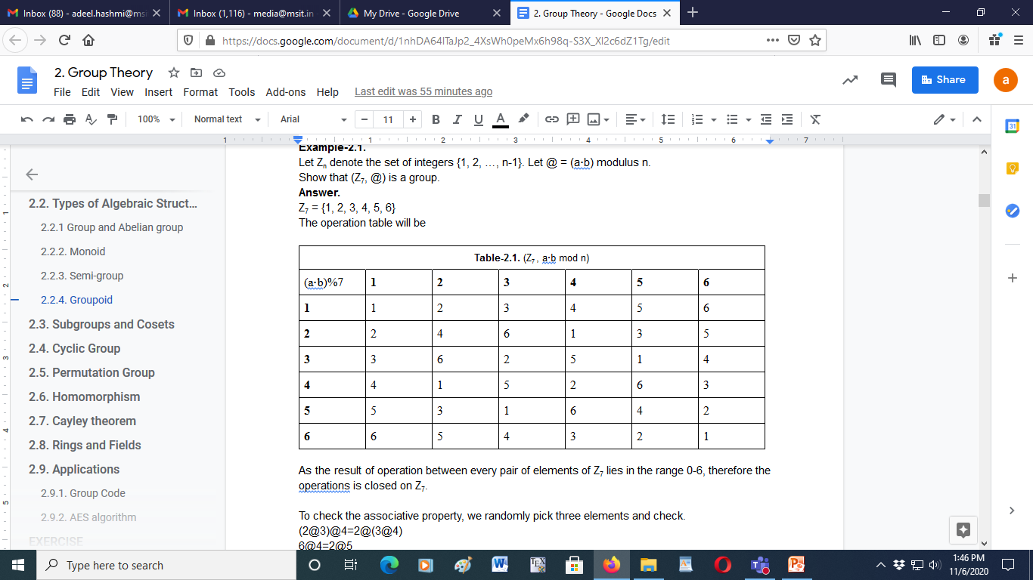
Question
Let Z_{n} denote the set of integers {1, 2, …, n-1}. Let @ = (a·b) modulus n.
Show that (Z₇, @) is a group.
Answer.
Z₇ = {1, 2, 3, 4, 5, 6}

Slide 12
Answer
As the result of operation between every pair of elements of Z₇ lies in the range 0-6, therefore the operations is closed on Z₇.
To check the associative property, we randomly pick three elements and check.
(2@3)@4=2@(3@4)
6@4=2@5
3=3
This is true for all combinations. Hence, the operation is associative.
From the table, clearly e (identity element) = 1 which exists in Z₇.
Let’s find inverse of each element.
From the table, 1⁻¹=1, 2⁻¹=4, 3⁻¹=5, 4⁻¹=2, 5⁻¹=3, 6⁻¹=6.
Hence, the inverse of each element of Z₇ exists in Z₇.

Slide 13
Sub-groups
Let G be a set and S be its subset.
Let (G,@) be a group.
If (S,@) is also a group then we say that (S,@) is a sub-group of (G,@).
If S is a proper subset of G then (S,@) is called proper subgroup of (G,@).

Slide 14
Cosets
Let (S,@) be a subgroup of group (G,@) and let y∈G.
Then the set {y@s:s∈S} is called the left coset generated by y and S, and is denoted by “yS”. Similarly, the set {s@y:s∈S} is called the right-coset and is denoted by “Sy”.
For example, let
G={…, -2, -1, 0, 1, 2, …}
S={…, -6, -3, 0, 3, 6, …}
Let y=2 and @=+
then
Sy = yS = {…, -4, -1, 2, 5, 8, …}
A sub-group (S,@) of a group (G,@) is said to be a normal subgroup of G if yS=Sy for all y∈G.

Slide 15
Index of sub-group
If (S,@) is a subgroup of group (G,@), then the number of distinct cosets of S in G, is called the index of S in G i.e. the number of disjoint cosets of S required to obtain G. For example, let
G={…, -3, -2, -1, 0, 1, 2, 3, …}
S={…, -9, -6, -3, 0, 3, 6, 9, …}
Let the binary operation be +, and let the cosets yS be 0S, 1S and 2S.
0S =0+S = {…, -9, -6, -3, 0, 3, 6, 9, …}
1S =1+S = {…, -8, -5, -2, 1, 4, 7, 10, …}
2S =2+S = {…, -7, -4, -1, 2, 5, 8, 11, …}
The cosets 0S, 1S and 2S are disjoint, and their union gives us G, hence index of S in G is 3.

Slide 16
Lagrange’s theorem
Lagrange’s Theorem: The order of a subgroup S of a finite group G is a divisor of the order of the group G.
i.e. Number of elements in G / Number of elements in S =
O(G) / O(S) = k
Proof:
Let cardinality of G be “n” and S be “m”. So size of each coset will also be “m”.
Let number of left or right disjoint cosets of S which generate G on union be “k”.
So, “k” cosets of size “m” merge to generate set G having size “n”.
Hence, n=m·k which gives (n/m)=k.

Slide 17
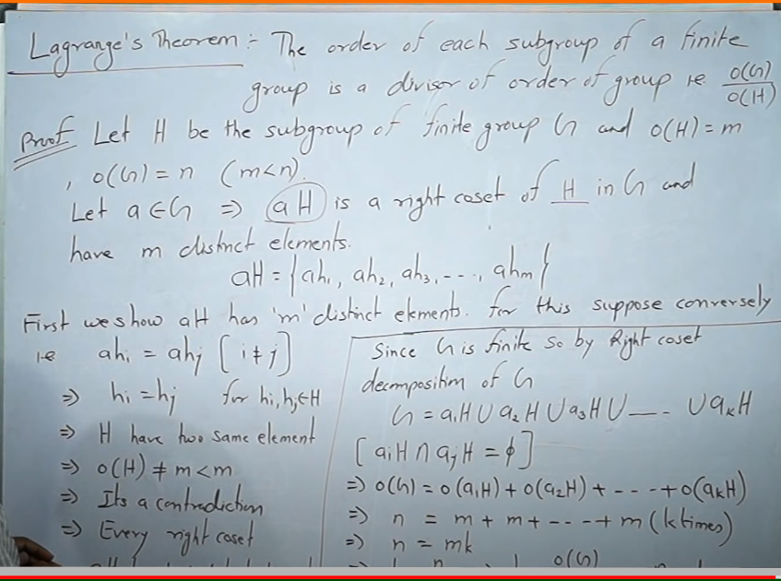

Slide 18
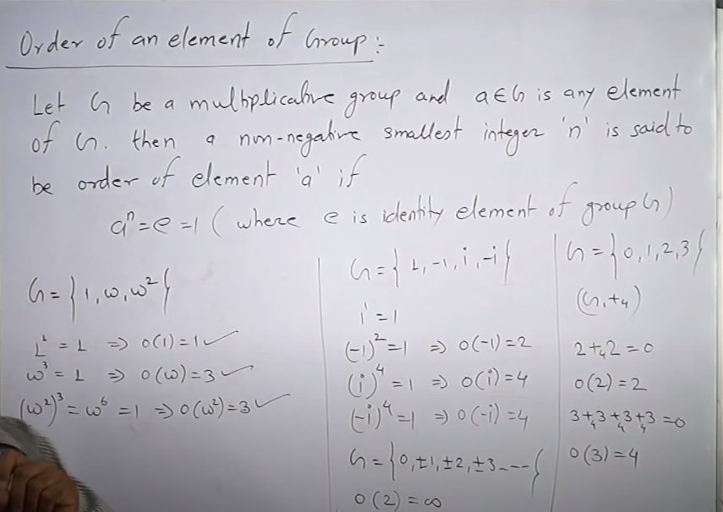

Slide 19
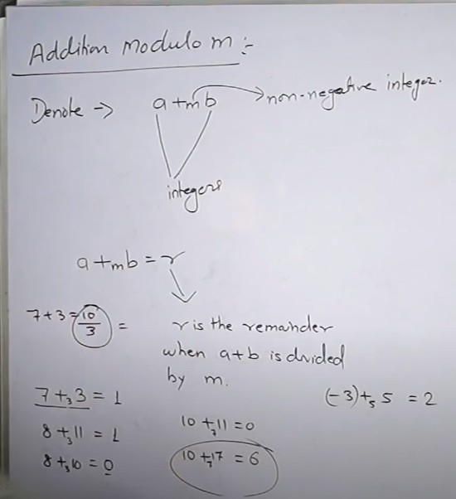

Slide 20
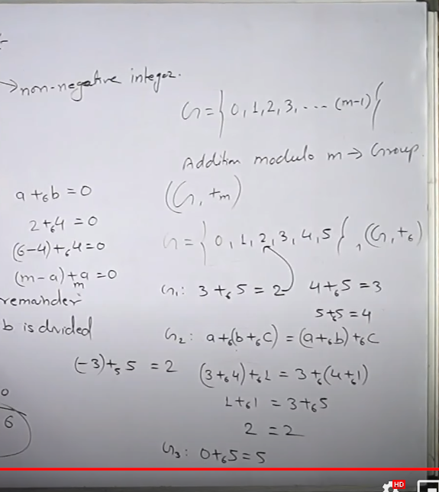
consider a set
inverse element
associative
identity element

Slide 21
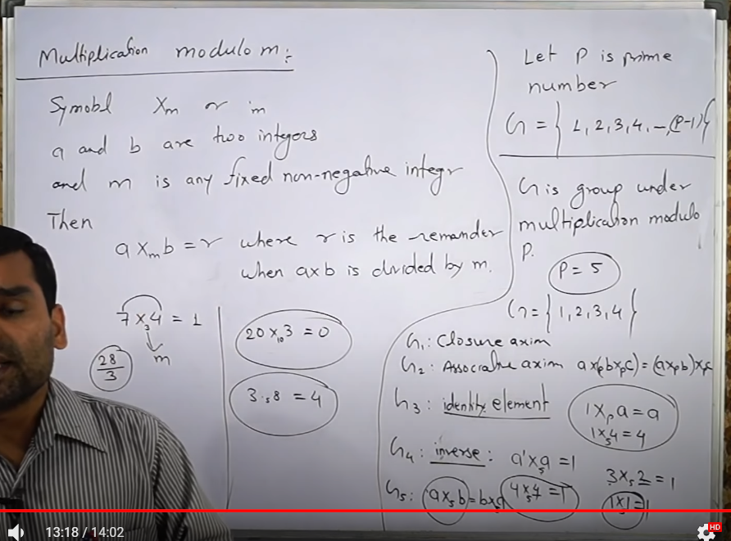

Slide 22
Cyclic Group
A group (G,@) is called a cyclic group, if for some g∈G, every element of G is of the form g^{n}, where “n” is some integer (g^{n} denotes the number of times operation @ is done on g). The element “g” is called the generator of the cyclic group (there may be multiple generators of a cyclic group).
The order of an element x in a group is “the least positive integer n such that x^{n}=e”, and we represent it as o(x)=n.

Slide 23
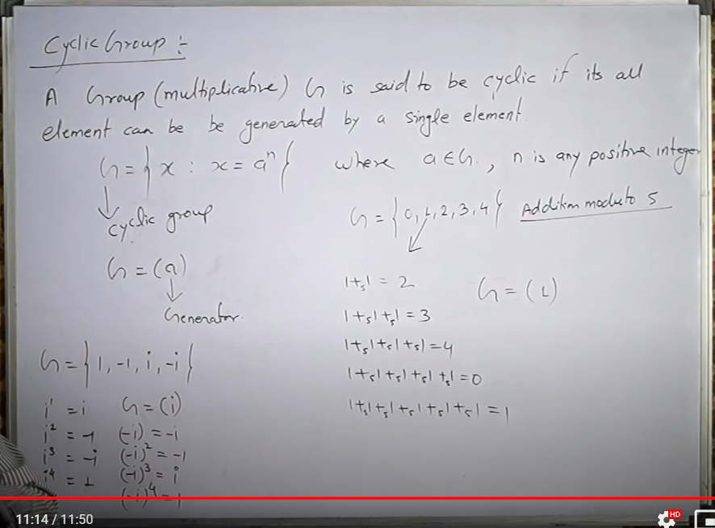

Slide 24
Example
Example
Show that the group (Z₇={0,1,2,3,4,5,6}, +₇) is also a cyclic group.
What is order of element 3?
Answer.
Let’s take g=3.
3%7=3 i.e. 3¹=3
(3+3)%7=6 i.e. 3²=6
(3+3+3)%7=2 i.e. 3³=2
(3+3+3+3)%7=5 i.e. 3⁴=5
(3+3+3+3+3)%7=1 i.e. 3⁵=1
(3+3+3+3+3+3)%7=4 i.e. 3⁶=4
(3+3+3+3+3+3+3)%7=0 i.e. 3⁷=0
The identity element for the operation +₇ on set Z₇ is 0 e.g. (5+0)%7=5.
The order of element 3 in the given cyclic group is 7 i.e. o(3)=7 as 3⁷=0 (as e=0 for given group).

Slide 25
Properties of Cyclic groups
All cyclic groups are abelian, as they obey the property g^{x}@g^{y}=g^{y}@g^{x}.
All prime groups (groups of order 1, 2, 3, 5, ...) are cyclic and abelian.
Every group of order p² (p is a prime integer) is also cyclic and abelian.

Slide 26
Questions
Show that every group of order ≤5 is cyclic and abelian.
Show that all proper subgroups of order 8 must be abelian.

Slide 27
Answers
We know that all prime groups are cyclic. So groups of order 1, 2, 3, 5 are cyclic. Every group of order p² is also cyclic. As 4=2², the group of order 4 is also cyclic.
According to Lagrange’s theorem, proper subgroups of group of order 8 can have order 1, 2 or 4. As all prime groups are abelian, therefore sub-groups of order 1 and 2 are abelian. Further, as every group of order p² (p being any prime number) is abelian, therefore group of order 4(2²) is also abelian.

Slide 28
Homo/Iso/Auto-morphism
Let (G,@₁) and (H,@₂) be two groups, and “f” be a function from G to H. Then “f” is called homomorphism of G into H, if for all a,b∈G, we have f(a@₁b)=f(a)@₂f(b).
A homomorphism of a group G into G is called an endo-morphism.
If “f” is one-to-one as well as onto, then it is called iso-morphism of G into H.
An isomorphism of a group G into G is called an auto-morphism.

Slide 29
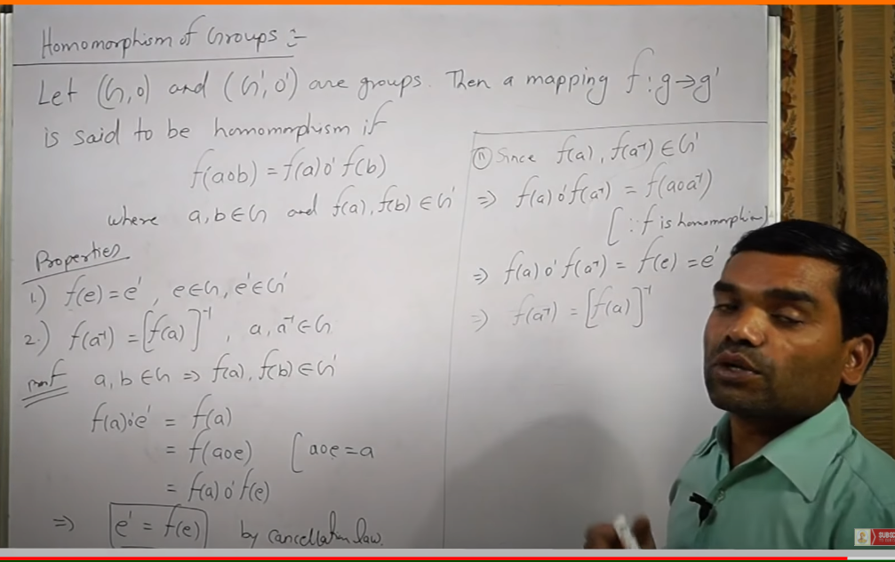

Slide 30
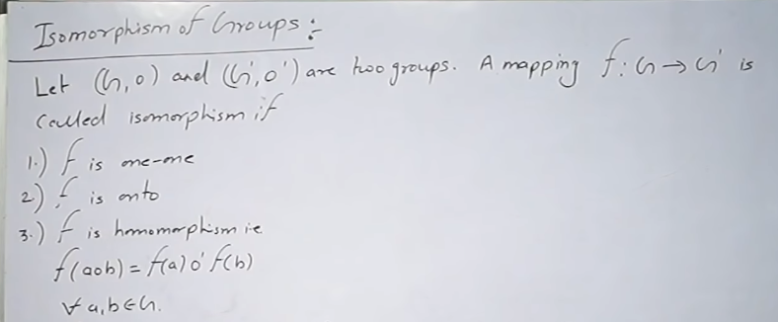

Slide 31
Example-1
Let the two groups be (R,+) and (R⁺,·) and the function be f:R→R⁺ where f(x)=e^{x}. [R=real number, R⁺ =positive real number]
Let’s first check for homomorphism,
f(a@₁b) = f(a+b) = e^{a+b}
f(a)@₂f(b) = f(a)·f(b) = eª · e^{b} = e^{a+b}
Hence, f(a+b) = f(a)·f(b) i.e. condition of homomorphism is
satisfied.
Now, we will check for isomorphism i.e. f(x)=e^{x} should be one-to-one as well as onto.
Checking for one-to-one i.e. e^{b} gives a unique value for every
unique value of b.
Checking for onto, if c∈R⁺, the (ln c)∈R.
Hence, f is an isomorphism.

Slide 32
Example-2
Let (R⁺,·) be a group, and f: R⁺ → R⁺ where f(x)=x².
f(a·b) = f(a)·f(b)
(a·b)² = a²·b²
(ab) ²=(ab) ²
Hence condition for homomorphism is satisfied.
f(x)=x² is one-to-one as well as onto for R⁺.
Hence, it is an auto-morphism.

Slide 33
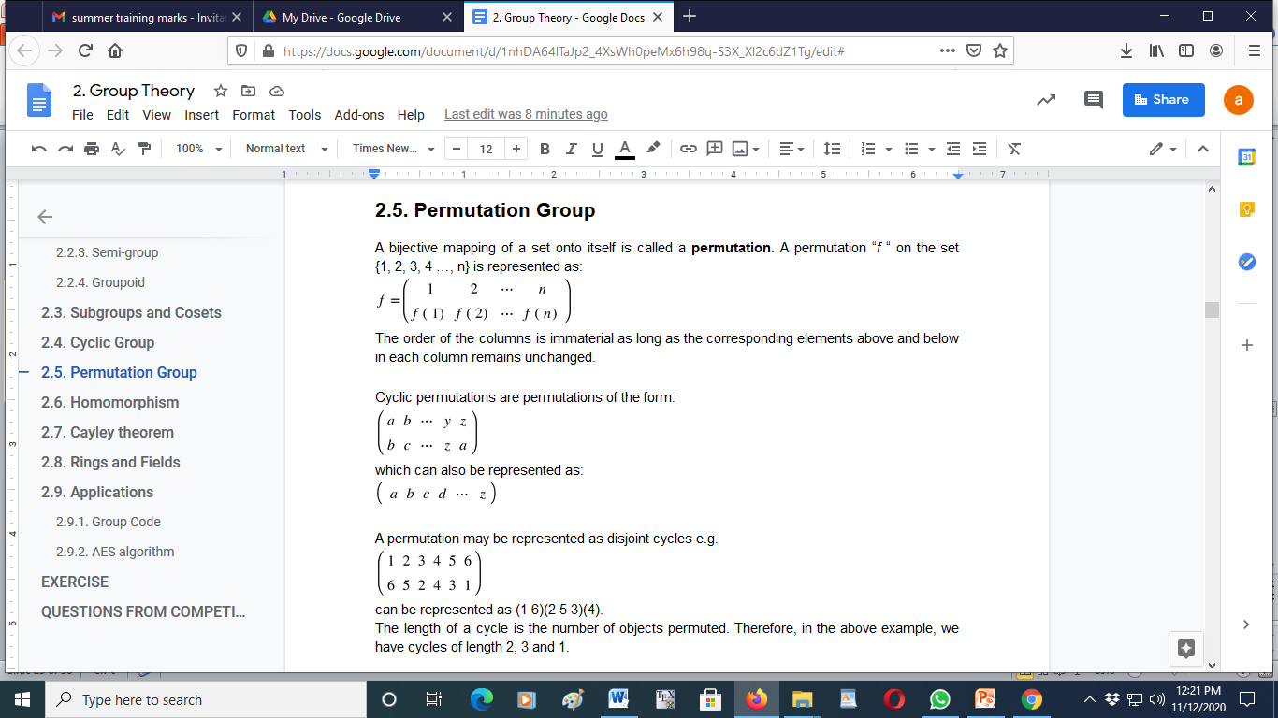
Permutation
A permutation “f “ on the set {1, 2, 3, 4 …, n} is represented as:

Slide 34
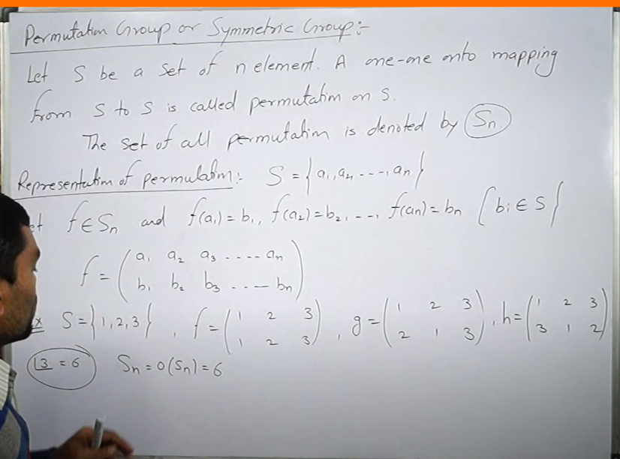
thre can be n! combinations for n elements in a group[. in {1,2,3}
there are 3 elements, hence 6 combinations are possible.

Slide 35
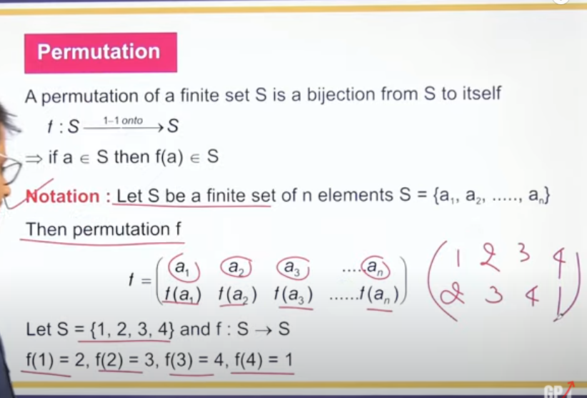

Slide 36
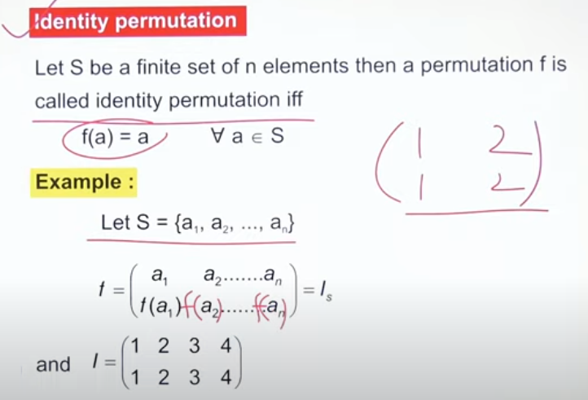
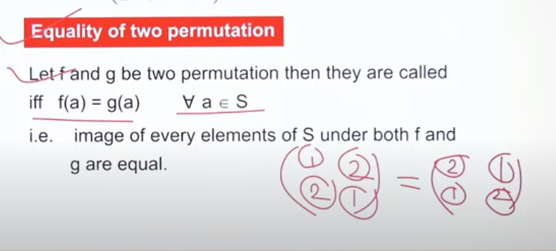

Slide 37
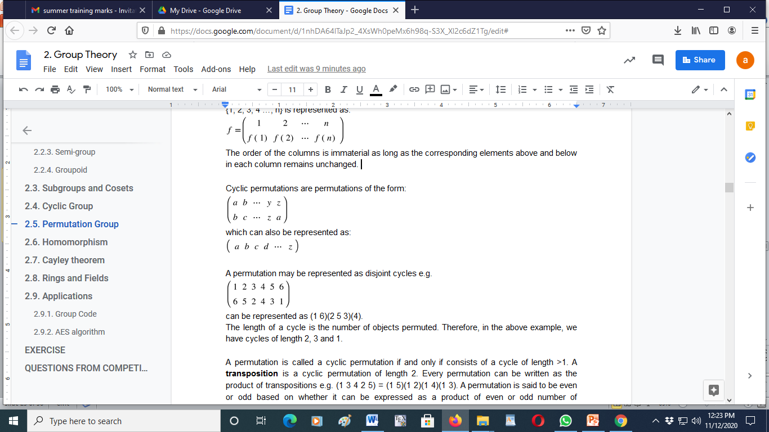
Cyclic Permutations

Slide 38
Transpositions
A permutation is called a cyclic permutation if and only if consists of a cycle of length >1.
A transposition is a cyclic permutation of length 2.
Every cyclic permutation can be written as the product of transpositions e.g.
(1 3 4 2 5) = (1 5)(1 2)(1 4)(1 3).
A permutation is said to be even or odd based on whether it can be expressed as a product of even or odd number of transpositions .

Slide 39
Permutation Set
A permutation set is a set of permutations involving all elements of a given set (i.e. a subset of set of permutations involving all elements).
A symmetric set is a permutation set having all possible permutations (involving all elements of the set) of a given set.
For example for set {1,2,3} the symmetric set will have all 6 possible permutations but the permutations set can be any subset of symmetric set.

Slide 40
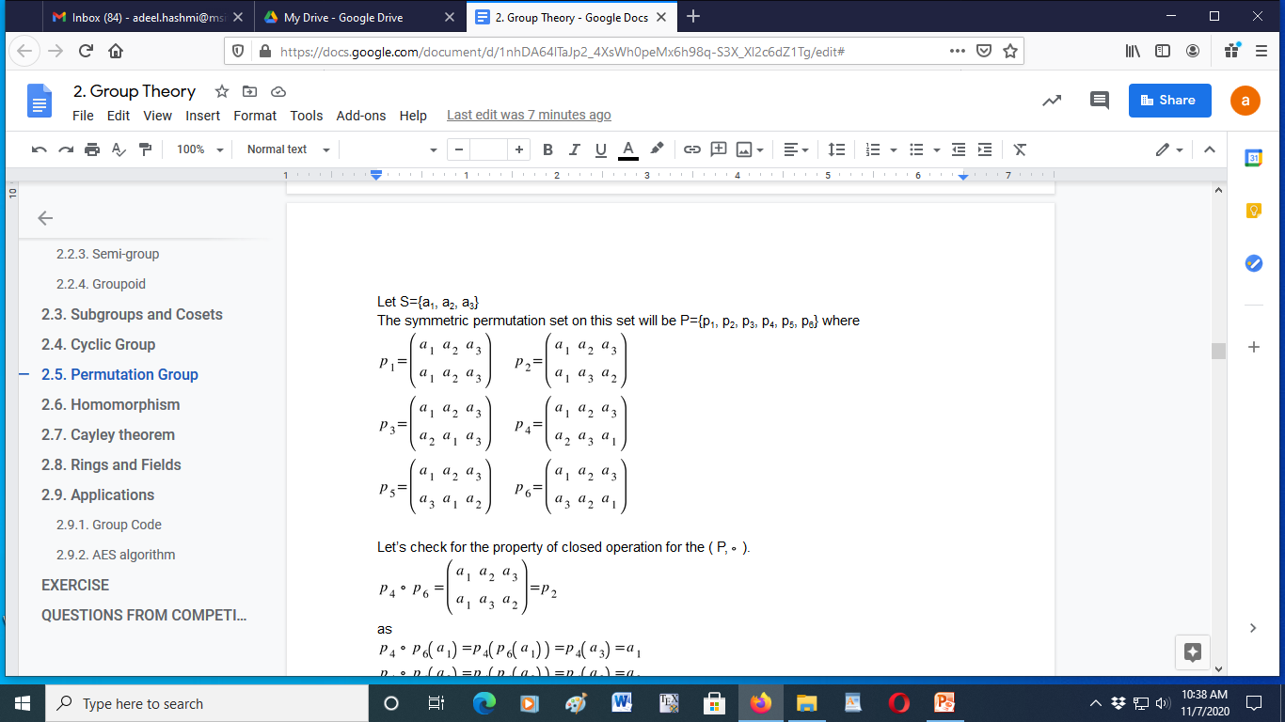
Example

Slide 41
Permutation Group
Let (P,◦) be an algebraic structure where P is a symmetric permutation set on a set S and ◦ is the composition operation. This algebraic structure (P,◦) satisfies all the properties of a group, hence it is called as permutation group.

Slide 42
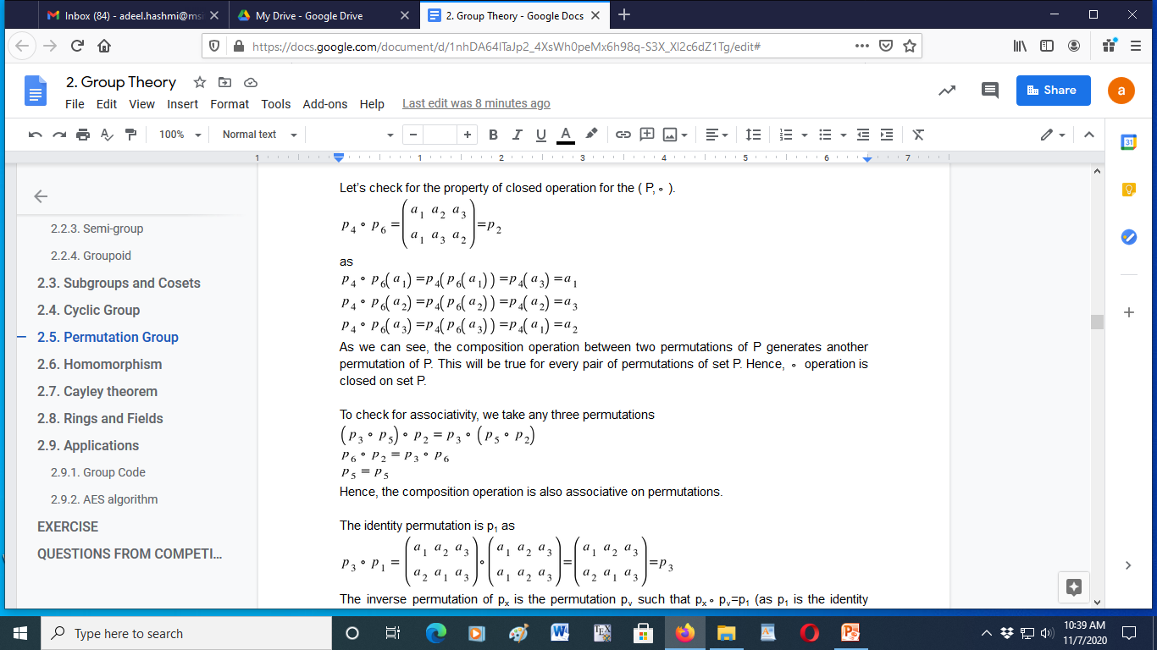
(P, ◦) is closed

Slide 43
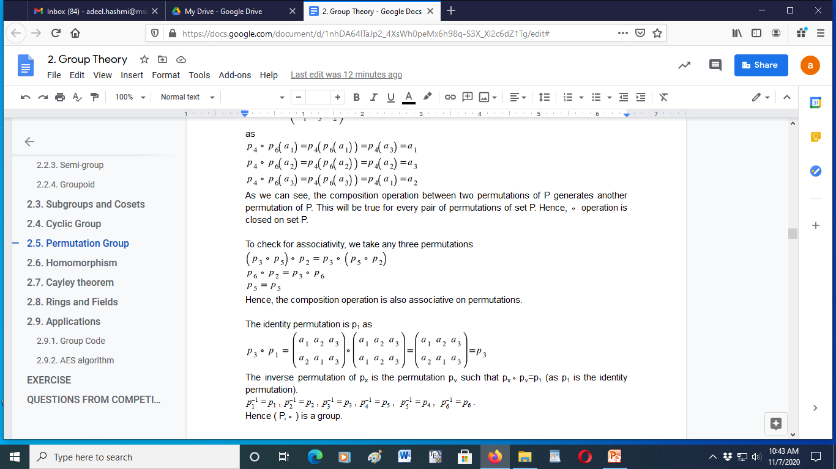
(P, ◦) is associative

Slide 44
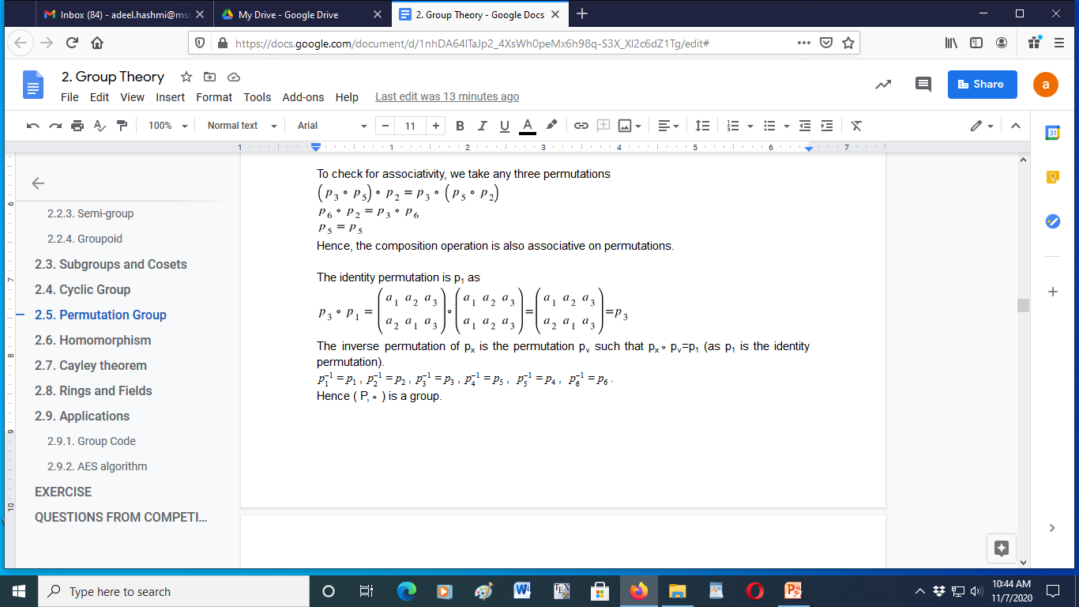
Identity and Inverse permutations

Slide 45
Cayley theorem
Cayley’s theorem states that “Any finite group is isomorphic to a permutation group”.

Slide 46
Example
Let, S={0,1,2} and the binary operation be +₃ [addition modulo 3] i.e. (a+b)%3.
(S,+₃) is a group.
The permutations formed by the elements of this group are
Let’s represent these permutations by p_{a}.
So, p₀={0,1,2}, p₁={1,2,0}, p₂={2,0,1}.
Table (S={0,1,2},@=+₃)
+₃ | b
a |  | 0 | 1 | 2
 | 0 | 0 | 1 | 2
 | 1 | 1 | 2 | 0
 | 2 | 2 | 0 | 1

Slide 47
Example (cont..2)
The total number of permutations possible on S={0,1,2} are 6 (3!) i.e.
{ {0,1,2},{0,2,1},{1,0,2},{1,2,0},{2,0,1},{2,1,0} }
Taking only permutations p₀={0,1,2}, p₁={1,2,0} and p₂={2,0,1} i.e. P={p₀, p₁, p₂}.
( P, ◦) forms a permutation group with the following permutation table.
Table ( P, ◦)
 | p₀ | p₁ | p₂
p₀ | p₀ | p₁ | p₂
p₁ | p₁ | p₂ | p₀
p₂ | p₂ | p₀ | p₁

Slide 48
Example (cont..3)
Let the function which maps S→P be f(a)=p_{a} for all a∈S.
This function is homomorphic if: f(a+₃b) = f(a) ◦ f(b)
Let, a=1, b=2 then
f(1+₃2) = f(1) ◦ f(2)
f(0) = f(1) ◦ f(2)
p₀ = p₁ ◦ p₂
p₀=p₀
This is true for all values of a,b∈S. Hence, it is a homomorphism.
As, f(a)=p_{a} is one-to-one as well as onto, it’s an isomorphism as well.

Slide 49
Rings
Ring is an algebraic structures are denoted by (S,+,ᐧ) where S is some set and + is called additive operation (not necessarily sum) on S and ᐧ is called multiplicative (not necessarily product) operation on S.
A ring has the following properties:
(S,+) is an abelian group.
(S,ᐧ) is a semi-group.
The operation ᐧ is distributive over operation + i.e. aᐧ(b+c)=(aᐧb)+(aᐧc).

Slide 50
Fields
Field is an algebraic structures are denoted by (S,+,ᐧ) where S is some set and + is called additive operation (not necessarily sum) on S and ᐧ is called multiplicative (not necessarily product) operation on S.
An algebraic structure (S,+,ᐧ) is called a field, if
(S, +) is an abelian group.
(S−{0},ᐧ) is an abelian group, where 0 is additive identity.
The operation ᐧ is distributive over operation +.

Slide 51
Examples
The set Z_{m}={0,1,2,...,m−1} under the operations of addition and multiplication modulo m is a ring.
If m is a prime, then Z_{m} is a field.

Slide 52
Thank You

